Slide 1


Capacity building experience on open-source real time payment systems in Tanzania
System integrator perspective
25 April 2022

Slide 2
Agenda
Introduction to UNCDF & our work
Project achievements & learnings
Panel discussion: System integrator perspective
Presenting the industry position paper
Q & A

Slide 3
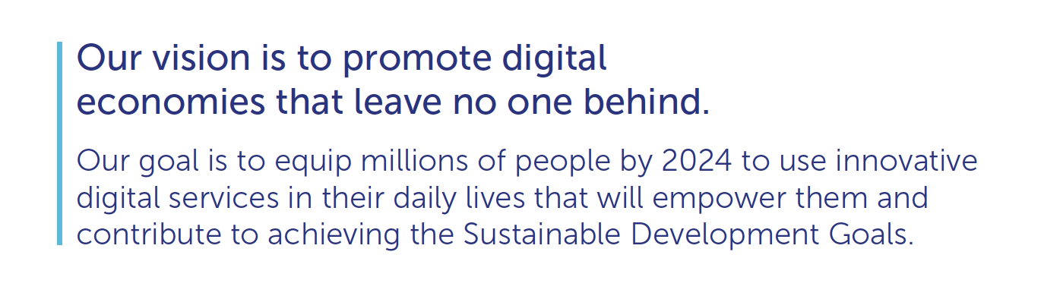
UNCDF
Inclusive Digital Economies: Market Development Approach

Slide 4




UNCDF Workstreams: Building Blocks for a Digital Economy
Policy & Regulation
Open Digital Payment Ecosystem
Working with governments to develop policies that support and provide an enabling environment for digital payments and services
Understanding the importance of digital payments as the basis for sustainable, economically impactful digital service
Skills
Inclusive Innovation
Helping users acquire the necessary skills (digital and financial) to adopt new digital services
Supporting entrepreneurs and MSMEs to build inclusive digital services that improve local livelihoods

Slide 5
Project achievements, learnings

Slide 6
Why the project,
A national OSS will drive;
Cheaper & more diverse digital products
Easier for payments to happen across different DFSPs
Smaller DFSPs more likely to roll out digital products in rural areas & reaching more women
Notes:
An open source payment system is a …….

Slide 7
Project results
Deployed a sandbox for training on the interoperable payments technology component
21 financial services providers (MFIs and SACCOs) engaged
2 system integrators fully integrated & supported to play the role of local capacity builders
11 FSPs fully integrated
6 DFSPs joined a Multi-tenant solution
Other support
Trainings on digital payments:
Open source, real-time payment systems
Business models
Use cases
Partnerships with other FSPs
Policy & advocacy
Training
Use of local capacity builders
Institutional strengthening of apex orgs & Evidence based advocacy
Creation of a sandbox/lab environment to fast-track learning

Slide 8
Project learnings
TECHNICAL
BUSINESS
BUSINESS
Changed the PM4ML to a single instance rather than for each DFSP level
Customised support geared towards Tier II and III DFSPs
Investments in and around digitization as a foundational element
Digitization makes both business & compliance sense (MFI Act 2018)

Slide 9
Challenges encountered
Lack of stable internet negatively affected participation in online trainings
100% virtual delivery of technical backstopping (due to covid) delayed pace of project implementation
Inability or lack of prioritization of some participating DFSPs to cover vendor related costs around API integrations
Important issues to note
Project related challenges
BoT priority currently focused on Tier I DFSPs. This would affect integration support for Tier II and III DFSPs.
Current limited options for the smaller DFSPs to Integrate to TIPS.
Smaller DFSPs face more foundational issues around acquiring core banking solutions.

Slide 10
Panel discussion with system integrators

Slide 11
Supporting evidence based advocacy
The industry position paper

Slide 12
Why the industry position paper
Describes the status of the MFI, SACCO industry and reviews the policies and regulations affecting the various Tiers
Aims to provide a snapshot analysis of the state of the MFI industry in Tanzania
Highlight options to accelerate MFI participation in Tanzania’s wider inclusive digital economy.

Slide 13
Challenges faced by MFIs
Institutional capacity, regulatory and technology limitations

Slide 14
Weak institutional position to drive digitization agenda
Governance structure
Staff turnover, skills & integrity
Portfolio quality
Funding costs

Slide 15
Regulatory limitations are impeding the growth of MFIs
Interest rate cap
MFIs are not a part of payment system
Compliance cost
Innovation approval processes

Slide 16
Technology constraints further limit their growth
Lack of or rudimentary IT systems
Low digital literacy

Slide 17
MFIs digital transformation
A roadmap

Slide 18
Digital transformation is essential for MFIs to remain competitive and better serve their clients
1. Digitize processes
2. Digitize product and business models
3. Digitize channels
4. Digitize engagement with people
Digitizing a number of repetitive and low-risk processes
Digitization for fostering innovation across products
Pillars for MFIs digital transformation
Technology can increase connectivity with customers and employees
Leverage technology to digitize traditional distribution channels

Slide 19
Recommendations
Support on digitization & shared systems
Creation of a sandbox
Evidence based advocacy

Slide 20
THANK YOU!

